Slide 1
Task 1. business Requirements analysis in Data Warehousing Process
Arun Sen
Department of Information & Operations Mgmt.
Mays Business School
Texas A&M University

Slide 2
Task 1. Business Requirements Analysis

Slide 3
Task 1. Business Requirements Analysis
1. Remember that
OLTP is a data capture system
Data Warehouse system is an information-delivery system

Slide 4
Task 1. Business Requirements Analysis
2. Requirement Analysis for data warehouse is “somewhat different”
In OLTP (say for order processing) world, users can describe what kinds of jobs they do and what kinds of reports are needed in these jobs
In Data Warehouse world, users cannot define precisely what they want from the data warehouse.
Do you want to find out what marketing managers do?
Do you want to support the problems they are facing such as “why the targeted customers stopped buying our brand?”
So, what to do????

Slide 5
Task 1. Business Requirements Analysis
3. Objectives of the Requirements Analysis in a DW project
Elicit Subject Area
Elicit Business Goals in the subject area
For each business goal, elicit Business Questions
Assessment of Business Questions using Data by Excel, Charts and Pivot Tables
Justify all Business Questions (BQs)

Slide 6
Task 1. Business Requirements Analysis
4. Questions to ponder in this step:
How to define a common subject area?
What are the key business metrics {e.g., sales price, dealer invoice, full price. etc. in auto industry)?
How to find the Business Goals?
For each goal, how to find Business Questions?
People in the business think in terms of “dimension”
Mktg VP -- how much sales did my new product generate by month, in the southern division, …Why some of them are low while others are different?
Mktg Manager -- give me sales figures by products - summarized by product categories, etc.
Financial Controller -- list actual vs. budget - month by month, ... Why there is a difference?
How to decide how much data must be used for each business questions?

Slide 7
Task 1. Business Requirements Analysis
4. Questions to ponder in this step:
How the users aggregate data?
How much data needed for user analysis?
How to find what data need to be accessed?
What is the data granularity?
How to estimate data warehouse size?
How to determine the refresh frequency?

Slide 8
Task 1. Business Requirements Analysis
5. Requirements Gathering Methods
Select the users (from senior executives, key departmental managers, business analysts, etc.)
Business Requirements Methodology used
Use SDLC-type Interview
JAD or Facilitated or Group Sessions (pp. 102-103 Pooniah)
Collect and review existing documentation

Slide 9
Task 1. Business Requirements Analysis
5. Things to collect
Current Information Sources
Subject Areas (which are most valuable, business dimensions, etc.)
Key Performance Metrics (performance measurement, critical success factors, etc.)
Information Frequency (how often data are updated, what is the timeliness requirements, ..)

Slide 10
Task 1. Business Requirements Analysis
6. Using SDLC-type Interview
Schedule small group of people
Less coordination
Prepare for Interview
Identify the interview team
Conduct pre-interview research
Select the interviewees
Prepare the questions
Schedule the interview
Prepare the interviewee
Conduct the interview
Interview wrap-up
Summarize and flush out
Create report for the DW developers

Slide 11
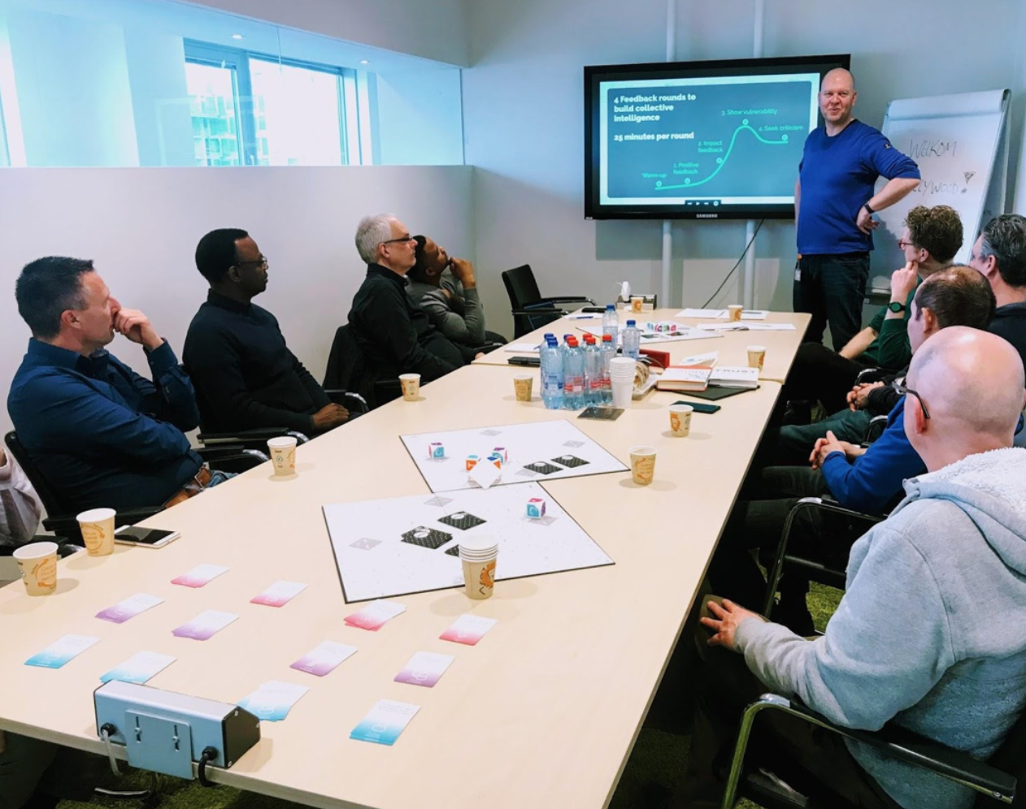

Task 1. Business Requirements Analysis
7. Using Facilitated Session
more coordination
but may reduce data requirements time
probably better method if you have some experience with the client’s work

Slide 12
Examples of Business Questions
A question requesting a comparison of weekly, monthly, quarterly, and yearly values is one of the simplest business questions posed during a sales analysis but expressing this question as a query represents a formidable challenge to the query writer, the query language, and the database server.
Business questions that request sequential processing are very difficult to express as SQL queries.
To derive a simple running total, for example, data analysts typically run several queries with a client tool, then paste the results together using another tool. This approach is awkward because it requires a sophisticated user and takes place on a client that is typically much slower than a database server.
SELECT
YEAR(sale_date) AS year,
DATEPART(WEEK, sale_date) AS week_num
SUM(amount) AS weekly_total
FROM sales
GROUP BY YEAR(sale_date), DATEPART(WEEK, sale_date)
ORDER BY year, week_num;
Source: http://publib.boulder.ibm.com/infocenter/rbhelp/v6r3/index.jsp?topic=%2Fcom.ibm.redbrick.doc6.3%2Fssg%2Fssg17.htm

Slide 13
Examples of Business Questions
sale_date | amount
2025-01-01 | 100
2025-01-03 | 200
2025-01-05 | 50
sale_date | amount | running_total
2025-01-01 | 100 | 100
2025-01-03 | 200 | 300
2025-01-05 | 50 | 350
SELECT
sale_date, amount,
SUM(amount) OVER (ORDER BY sale_date) AS running_total
FROM sales;
Source: http://publib.boulder.ibm.com/infocenter/rbhelp/v6r3/index.jsp?topic=%2Fcom.ibm.redbrick.doc6.3%2Fssg%2Fssg17.htm

Slide 14
Examples of Business Questions
Easy
What were the weekly sales of Lotta Latte brand coffee in Houston during last year?
What were the average monthly sales of all coffee products in the West during each month of last year?
Moderately difficult
How do the sales of Lotta Latte in Houston compare with its sales in Los Angeles and New York?
How has the monthly market share of Lotta Latte changed during the last two years in all markets?
Which suppliers charge the most for bulk tea products?
What was the most successful promotion last December in California?
Very difficult without OLAP functions
What were the running totals for Lotta Latte sales during each month of last year?
What were the ratios of monthly sales to total sales (expressed as percentages) for Lotta Latte during the same period?
Which ten cities had the worst coffee sales in 1998 with regard to dollar sales and quantities sold?
Which Aroma stores fall into the top 25 percent in terms of sales revenue for the first quarter of 1999? Which stores fall into the middle 50 percent, and the bottom 25 percent?
Source: http://publib.boulder.ibm.com/infocenter/rbhelp/v6r3/index.jsp?topic=%2Fcom.ibm.redbrick.doc6.3%2Fssg%2Fssg17.htm
2/1/2026
Copyright (c) Arun Sen Texas A&M University
14

Slide 15
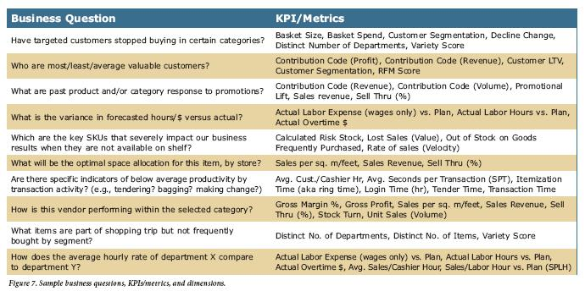
Examples of Business Questions
in Retail subject area
Source:
http://www.teradata.com/resources/white-papers/Teradata-Enterprise-Data-Warehouse-Roadmap-Model-for-the-Retail-Industry-eb5645/

Slide 16
Some More Examples of Business Questions
in Retail subject area
Need to see daily, weekly, monthly, quarterly profit of each store.
Comparison of sales and profit on various time periods.
Comparison of sales in various time bands of the day.
Need to know which product has more demand on which location?
Need to study trend of sales by time period of the day over the week, month, and year?
On what day sales is higher?
On every Sunday of this month, what is sales and what is profit?
What is trend of sales on weekday and weekend?
Need to compare weekly, monthly and yearly sales to know growth and KPI?
Source: https://www.codeproject.com/Articles/652108/Create-First-Data-WareHouse

Slide 17
Remember for Business Questions
in any subject area
For Each Business Question
Justify why it is needed for the Client (ask questions to clear this up
Look at the data to see if it can be answered using the data
Think of a “Chart” or a “Table” to show the data to the Client
Source: https://www.codeproject.com/Articles/652108/Create-First-Data-WareHouse

